Slide 1



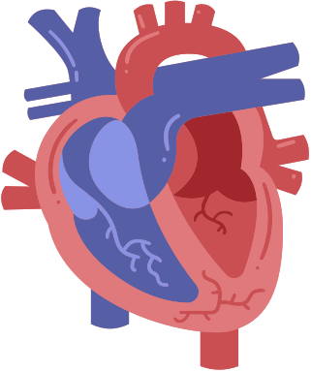


HEART DISEASE
PREDICTION
SURYAVAMSI ABHISHEK
sshannu568@gmail.com

Slide 2

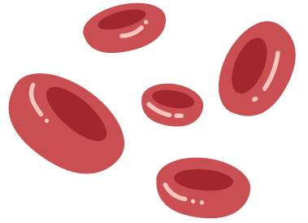


PREDICTING HEART DISEASE USING MACHINE LEARNING MODELS
Challenges:
Challenges in Heart Disease Prediction
•Early diagnosis is crucial to prevent severe healthoutcomes.
•Data includes a wide range of health parameters, making it complex.
•Need for high accuracy to reduce false positives and negatives.
Objective:To develop a predictive model to accurately diagnose heart disease based on patient health parameters and medical history.

Slide 3

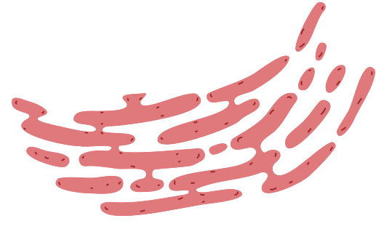
RAPIDMINER OVERVIEW
WHY RAPIDMINER?
WORKFLOW IN RAPIDMINER
A user-friendly platform with a drag-and-drop interface, offering a comprehensive machine learning experience. It supports a wide range of algorithms, including XGBoost, ensuring versatility and ease of use.
Data Preprocessing: Transforming and organizing data to ensure it's ready for analysis.
Model Training: Seamlessly developing an XGBoost model using the RapidMiner platform.
Evaluation: Measuring the model’s performance using a variety of assessment criteria.

Slide 4



METHODOLOGY
STEP 1
DATA IMPORTING: THE PROCESS STARTS BY BRINGING THE DATASET INTO A DATA ANALYSIS PLATFORM OR PROGRAMMING ENVIRONMENT, SUCH AS RAPIDMINER. THIS INVOLVES LOADING THE DATA FROM SOURCES LIKE FILES OR DATABASES.
Data Cleaning: Once the data is imported, the next step is to clean it. This includes addressing missing values, eliminating duplicates, and resolving other inconsistencies. Cleaning ensures the data is accurate, reliable, and ready for analysis.
Data Analysis: The dataset is then examined, focusing on correlations with the target variable using a correlation matrix. Features with weak correlations were removed based on a set threshold to prioritize the most important variables. Visualization tools like scatter plots and deviation graphs were utilized to explore the relationships between features and the target, helping to reveal patterns that could improve model performance.

Slide 5
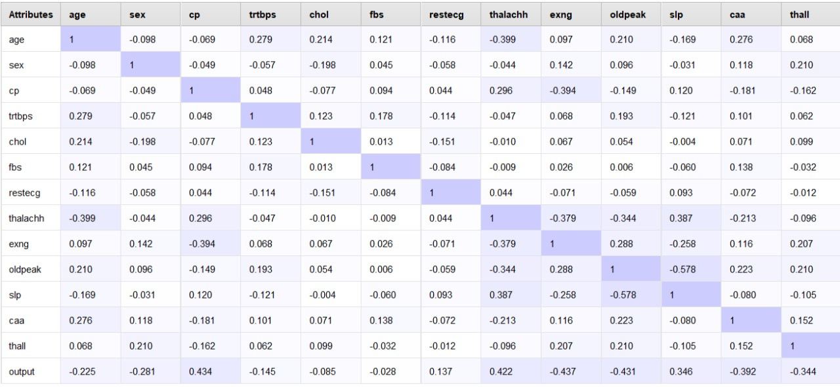


Correlation Matrix
Let’s take a closer look at the three types of blood vessels:
It has the thickest wall of all three, allowing it to withstand the high pressure created by the heart.
Artery
It has the thinnest wall to allow substances such as oxygen and sugars to pass through its wall—into or out of the blood.
Capillary
It is less muscular and stretchy than an artery, so blood moves through it with low pressure. It also has a special valve that helps blood go only one way.
Vein

Slide 6
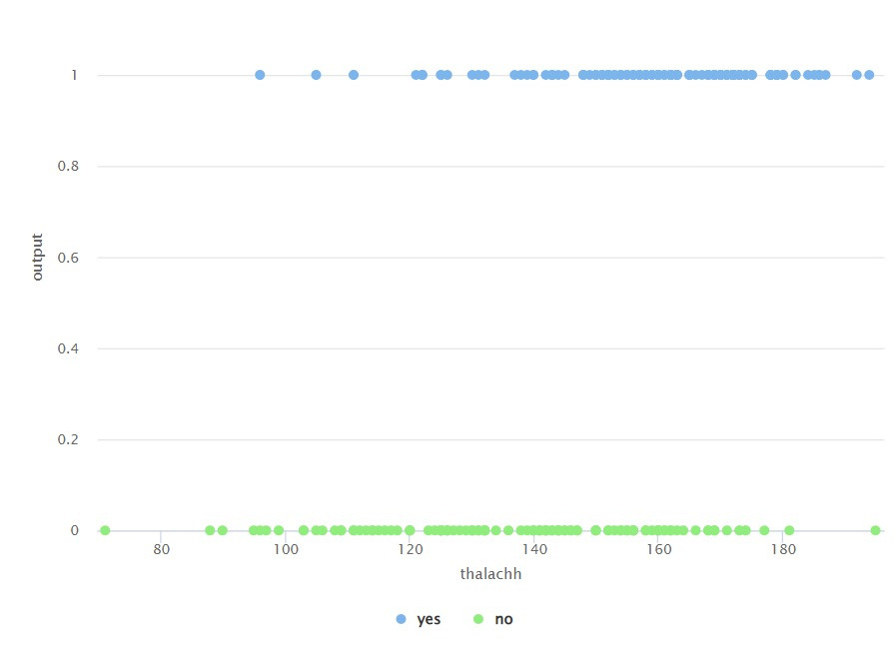
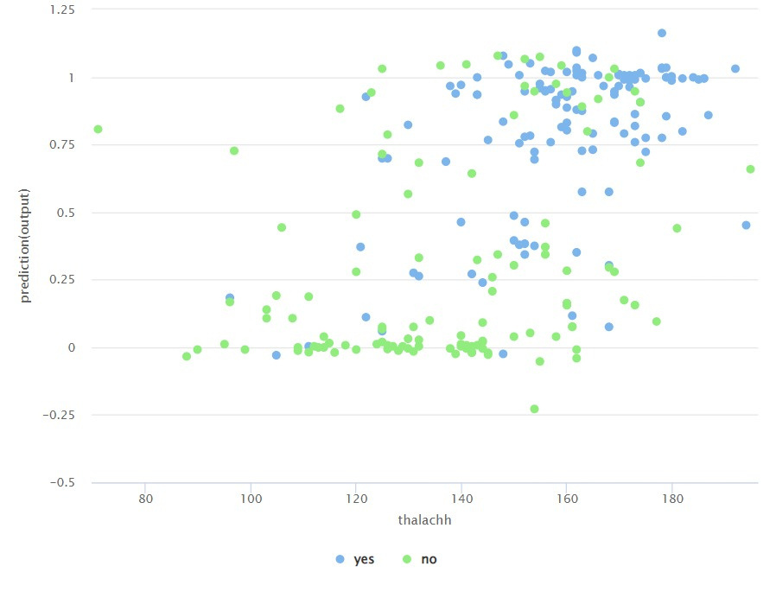

Data Analysis

Slide 7
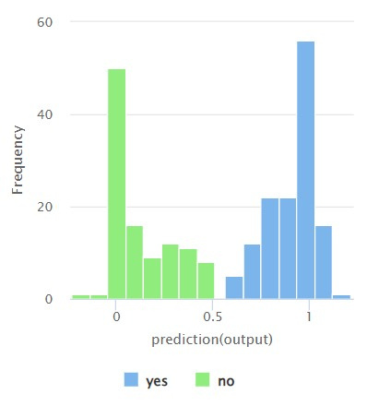
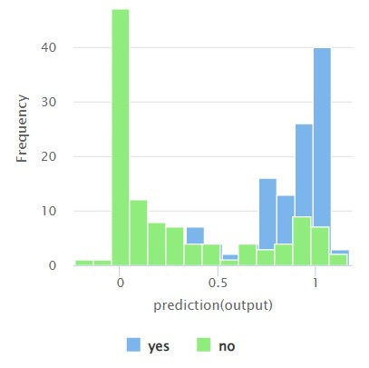
Data Analysis

Slide 8

METHODOLOGY
STEP 2
Each type of blood vessel has a unique role in the circulatory system.
AFTER LOADING THE ANONYMIZED MERCEDES CAR CONFIGURATION DATASET, PREPROCESSING IS PERFORMED TO PREPARE IT FOR ANALYSIS. EACH VARIABLE CORRESPONDS TO A SPECIFIC CUSTOM FEATURE, WHILE THE TARGET VARIABLE 'Y' REPRESENTS THE TIME (IN SECONDS) IT TOOK FOR THE CAR TO COMPLETE TESTING.
MODEL SELECTION:
XGBOOST WAS SELECTED FOR ITS ROBUST PERFORMANCE WITH LARGE, FEATURE-RICH DATASETS. USING A GRADIENT-BOOSTING FRAMEWORK, XGBOOST ITERATIVELY IMPROVES PREDICTION ACCURACY BY LEARNING FROM ERRORS IN WEAKER MODELS. THE MODEL:
EMPHASIZES KEY FEATURES: HIGHLIGHTS THE MOST INFLUENTIAL FEATURES AFFECTING TESTING TIME.
REDUCES PREDICTION ERRORS: OPTIMIZES PREDICTIONS TO MINIMIZE DISCREPANCIES IN TESTING TIME.
MANAGES FEATURE INTERACTIONS: SKILLFULLY HANDLES COMPLEX INTERDEPENDENCIES BETWEEN VARIOUS CAR FEATURES.
Vein
Carries blood away from the heart
Assists in the exchange of substances between the blood and tissues
Carries blood back towards the heart
TIP
Remember ‘A’ for ‘artery’ and ‘away’ from the heart!

Slide 9
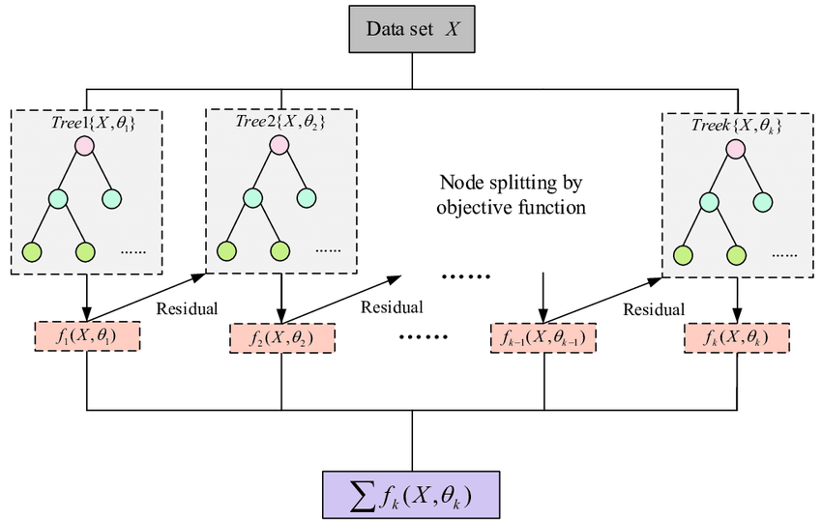

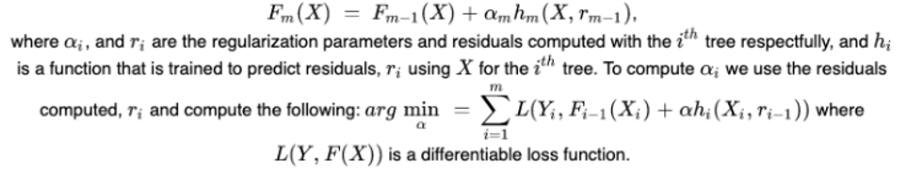
XG Boost Algorithm

Slide 10
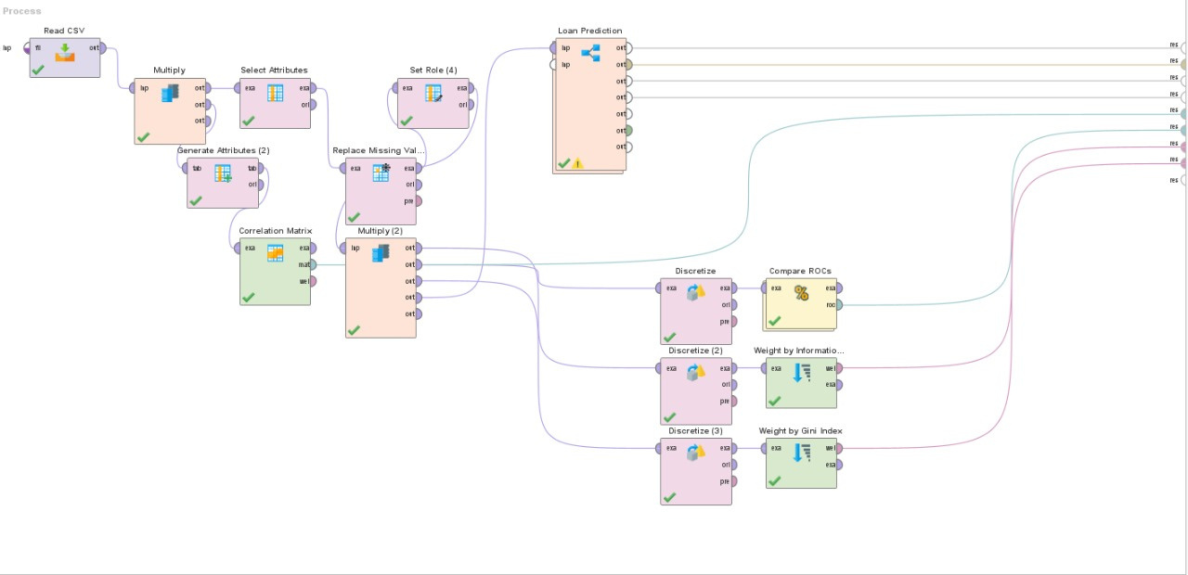
Complete Process Design

Slide 11
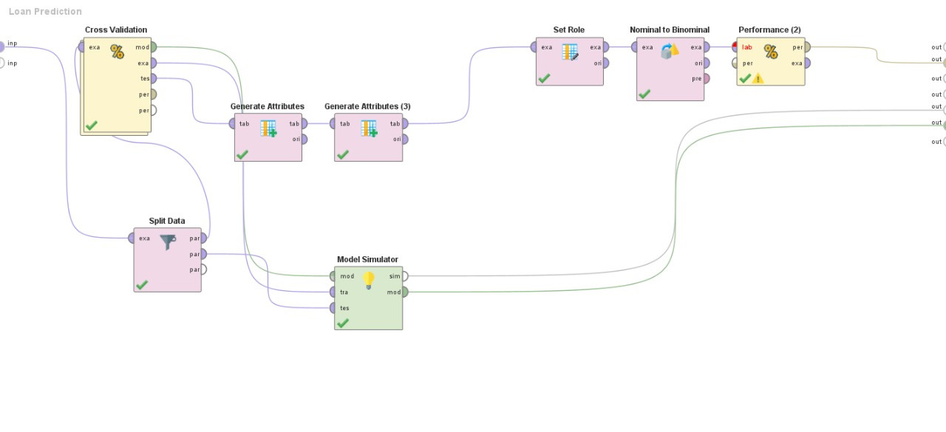
Loan Prediction Design

Slide 12
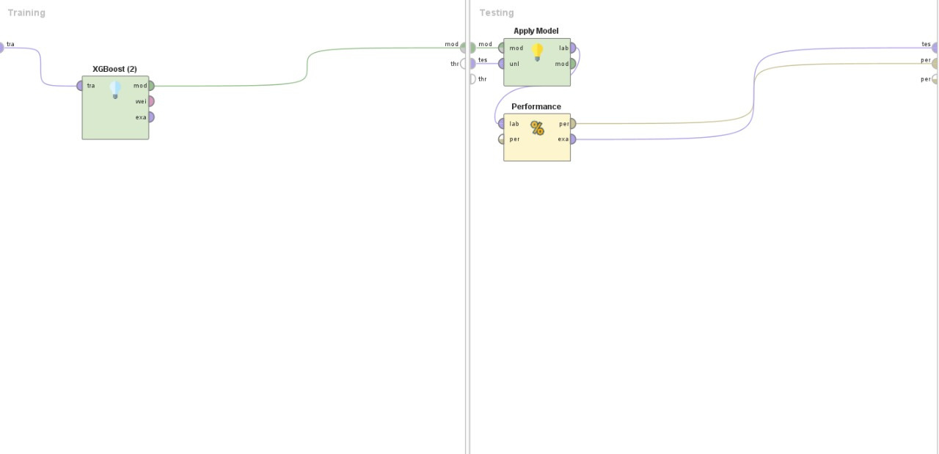
Cross Validation

Slide 13


METHODOLOGY
STEP 3
CROSS-VALIDATION:
A K-FOLD CROSS-VALIDATION METHOD WAS APPLIED TO AVOID OVERFITTING AND ASSESS THE MODEL’S PERFORMANCE ON MULTIPLE DATA SPLITS. THIS ENSURED THAT THE MODEL COULD GENERALIZE WELL TO NEW, UNSEEN DATA.
MODEL EVALUATION:
THE TRAINED XGBOOST MODEL WAS THEN TESTED ON A SEPARATE TEST SET. KEY PERFORMANCE INDICATORS, INCLUDING ACCURACY, PRECISION, RECALL, F1-SCORE FOR CLASSIFICATION, AND RMSE OR MAE FOR REGRESSION TASKS, WERE CALCULATED. RESULTS WERE ANALYZED USING A CONFUSION MATRIX OR ERROR METRICS, HIGHLIGHTING AREAS WHERE THE MODEL MIGHT BE UNDERPERFORMING. THESE INSIGHTS PROVIDED A CLEAR UNDERSTANDING OF THE MODEL’S ACCURACY AND ITS ABILITY TO GENERALIZE TO NEW DATA

Slide 14
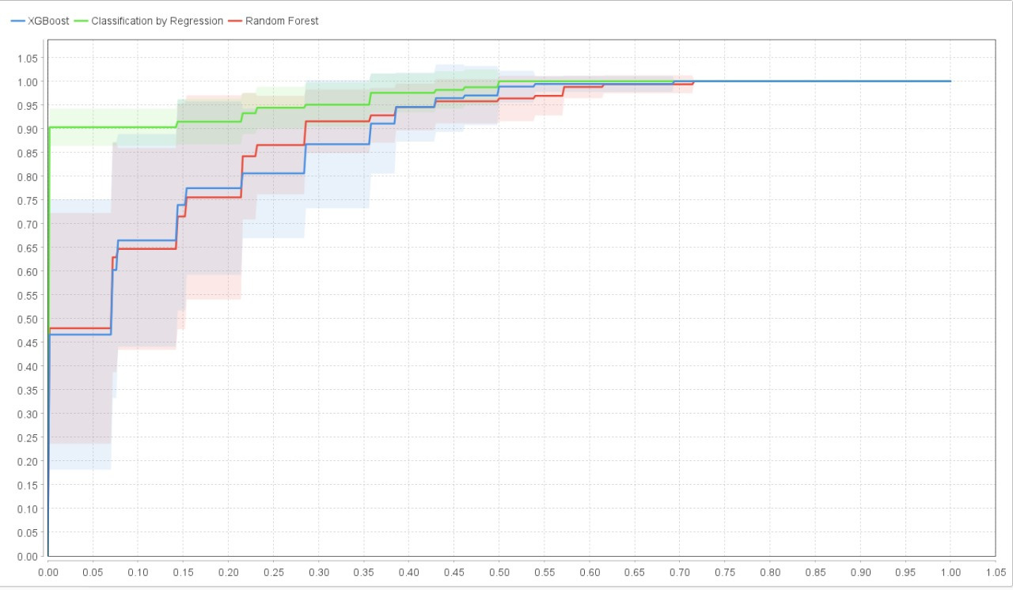

ROC Curve Analysis
Try this background for online class.
*Please delete this section before downloading.

Slide 15
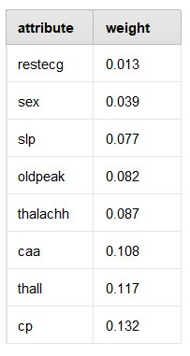
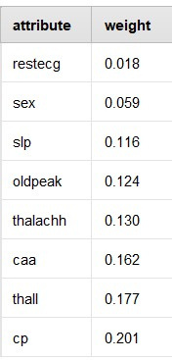
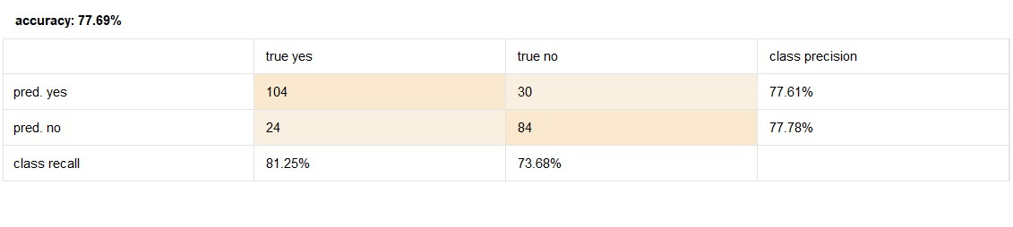
Model Prediction

Slide 16
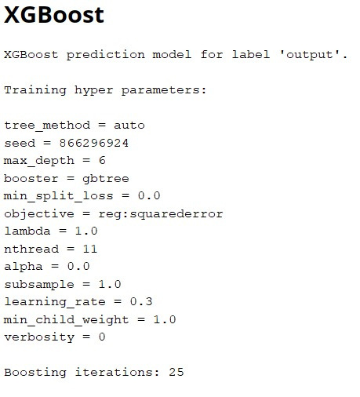
Model Evaluation

Slide 17


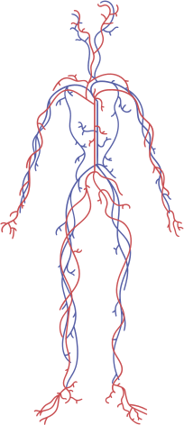

THANK YOU

